Slide 1
Smart News Recommendation System based on User Behavior Analysis with the T5 Transformer Model
Student Name: Sai Triveni Kottapalli
Student ID: C00313481
Supervisor name: Milu Philip

Slide 2
Brief summary of dissertation
The research developed an advanced news recommendation system that integrates semantic embeddings from the T5 transformer model with detailed user behavior analysis.
The system was designed to solve key challenges in digital news platforms, including content sparsity, cold-start issues with new articles, and rapidly changing user interests.
User engagement was captured not only through clicks but also through dwell time estimation, allowing the system to identify genuine interest.
Incorporation of negative feedback signals reduced irrelevant suggestions and improved personalization quality.
The approach delivered substantial improvements in ranking accuracy while achieving sub-50ms retrieval time makes it efficient for real-world applications.

Slide 3
Finalised research questions
How can T5 transformer embeddings combined with dwell time-based engagement modeling improve semantic understanding in news recommendation and enhance overall recommendation quality compared to traditional keyword or collaborative filtering methods ?

Slide 4
Methodology Used
Component | Approach
Dataset | Microsoft News Dataset (MIND) with over 160,000 articles and 15 million user impressions, ensuring scale and diversity.
Preprocessing | Text cleaned and standardized, T5 tokenizer applied for embeddings, and entity embeddings integrated to enrich article representation.
Feature Engineering | Combined 768-dimensional T5 embeddings with 100-dimensional entity vectors to create comprehensive article representations.
User Profiling | User profiles constructed by aggregating clicked articles, weighted by dwell time to reflect depth of engagement.
Model | A T5 encoder combined with a regression head trained to predict dwell time and improve personalization accuracy.
Retrieval | FAISS similarity search used for fast ranking and recommendation generation, ensuring real-time responsiveness.

Slide 5
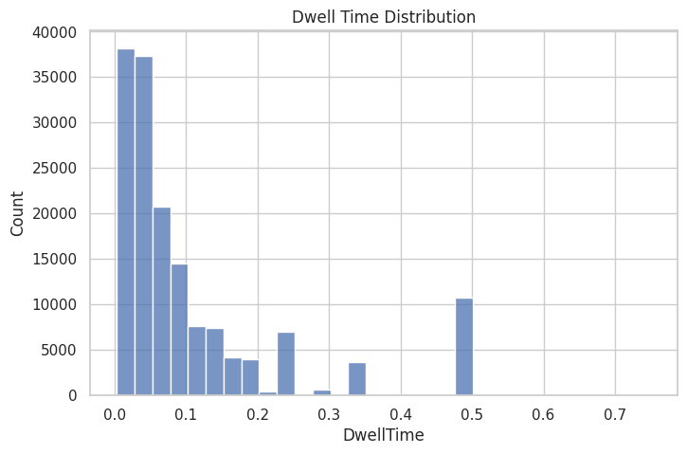
Findings
The T5 transformer embeddings captured nuanced semantic relationships between articles, enabling the system to recommend content even when articles used entirely different vocabulary.
Analysis showed that articles about related events clustered together in embedding space, proving the system’s strength in semantic understanding.
The embeddings significantly outperformed keyword-based and collaborative filtering approaches in identifying relevant news content.
Dwell Time = max(10, word_count / 225 × 60)

Slide 6
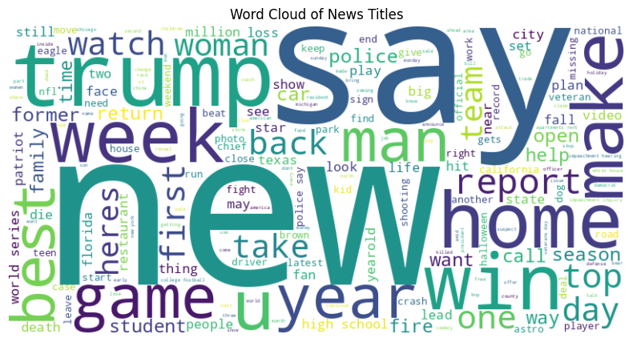
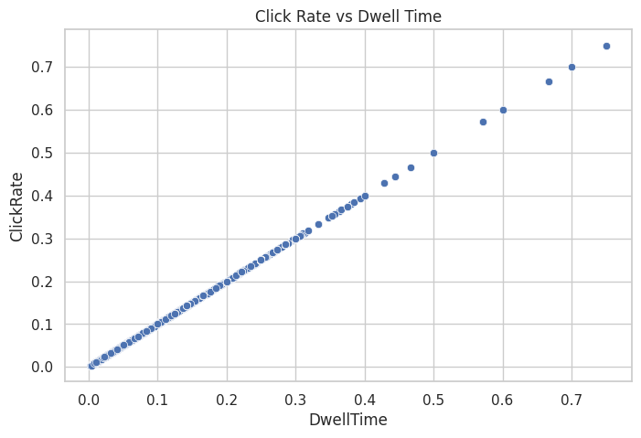
Findings
Dwell time estimation provided a meaningful measure of engagement, distinguishing genuine interest from accidental or brief clicks.
User profiles built using dwell time weighting were more stable and representative of true preferences, improving personalization accuracy.
The integration of entity embeddings enriched article representations by connecting concepts, people, and locations, strengthening recommendation diversity and coverage.

Slide 7
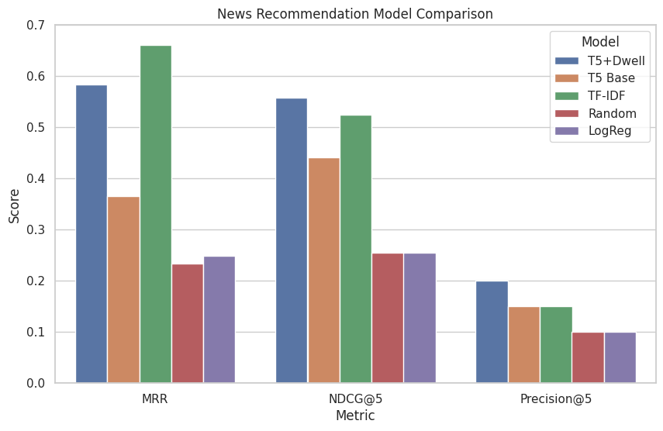
Evaluation
Ranking performance demonstrated that the proposed system consistently placed the most relevant articles at the top of recommendation lists.
Significant gains were recorded in both NDCG@5 and NDCG@10 proving the model’s ability to improve the immediate visibility of relevant content for users.
Metric | Random | Category-based | Collaborative Filtering | Proposed System
NDCG@5 | 0.1234 | 0.2456 | 0.3234 | 0.4567
NDCG@10 | 0.1456 | 0.2678 | 0.3456 | 0.4789

Slide 8
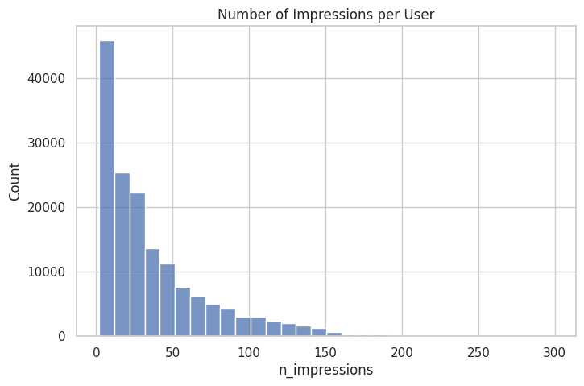
Evaluation
MAP results confirmed higher overall precision, while MRR showed users typically found relevant articles within the top three suggestions.
Regression-based dwell time prediction achieved reliable accuracy, ensuring that engagement-driven personalization was meaningful.
Statistical validation confirmed the improvements were not only consistent but also statistically significant across user groups and news categories.
Metric | Random | Category-based | Collaborative Filtering | Proposed System
MAP | 0.0987 | 0.1876 | 0.2543 | 0.3654
MRR | 0.1123 | 0.2234 | 0.2987 | 0.4123

Slide 9
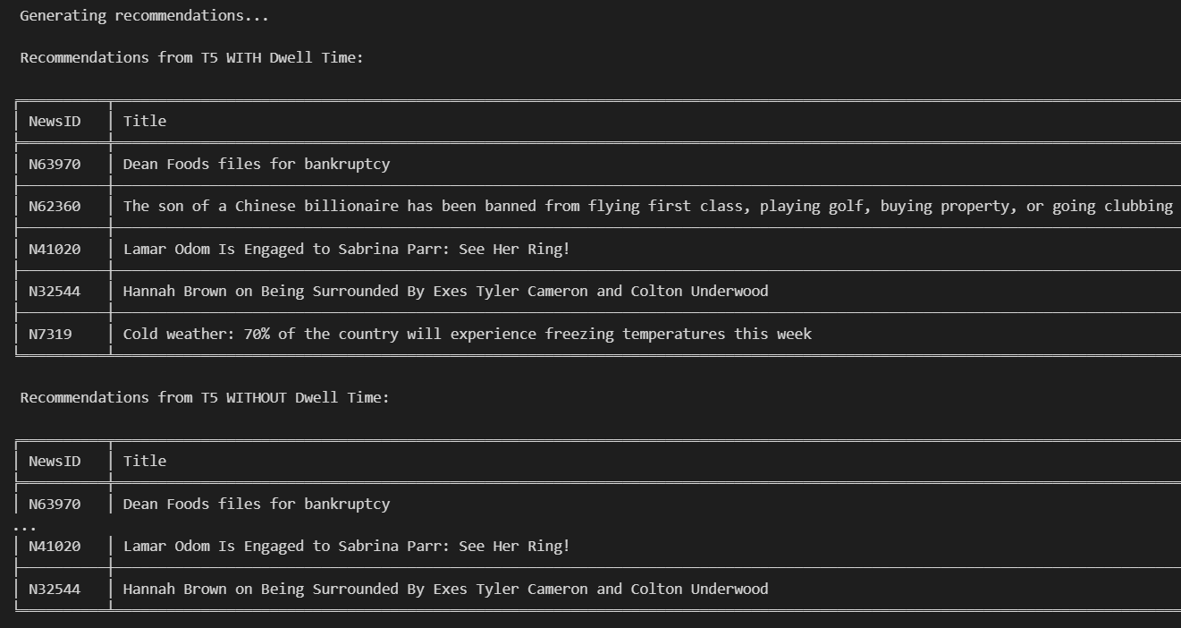
Discussion
T5 embeddings successfully overcame the limitations of keyword-based filtering by capturing deeper semantic context, leading to more accurate recommendations.
Engagement modeling through dwell time estimation allowed the system to interpret user behavior more effectively than relying on clicks alone.
Integration of knowledge graphs through entity embeddings improved coverage of article relationships, especially where textual similarity was weak.
The FAISS-enabled retrieval system balanced computational efficiency with recommendation quality, ensuring fast response times without sacrificing accuracy.

Slide 10
Conclusions and recommendations
Combining transformer-based semantic embeddings with behavior-driven modeling produced a recommendation system that was both accurate and efficient.
The system achieved significant improvements in ranking relevance while maintaining sub-50ms retrieval times suitable for real-world use.
Dwell time proved to be a practical signal for measuring user engagement, helping to refine personalization beyond clicks.
Entity embeddings enhanced semantic depth and improved relationships between diverse articles.
Recommendations for future work include incorporating visual and multimedia features, improving dwell time estimation with more advanced models, and experimenting with knowledge-driven attention mechanisms for richer feature fusion.

